Slide 1
Securing Your Data With SQL 2016 (An overview of Always Encrypted)
Md. Sultan-E-Alam Khan, PMP®, SMC™, OCP, MCSD | Head of Application, Lanka Bangla
SQLSaturday #533 - Bangladesh 2016

Slide 2
Topics of Discussion
Securing Your Database
History of Database Encryption
Always Encryption
Performance Benchmarking
Limitations
References

Slide 3
Securing Your Database

Slide 4
Security
Protecting your legal assets from the illegal access

Slide 5
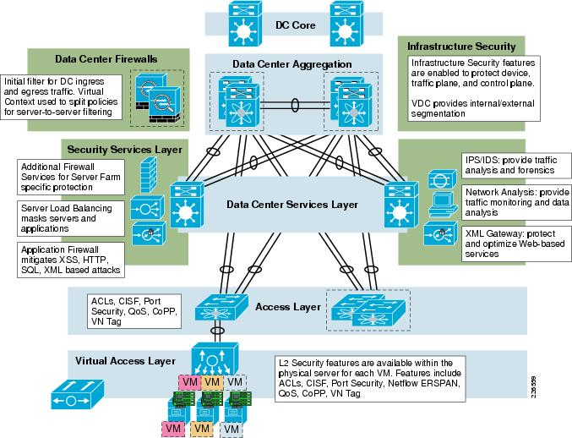
Security

Slide 6
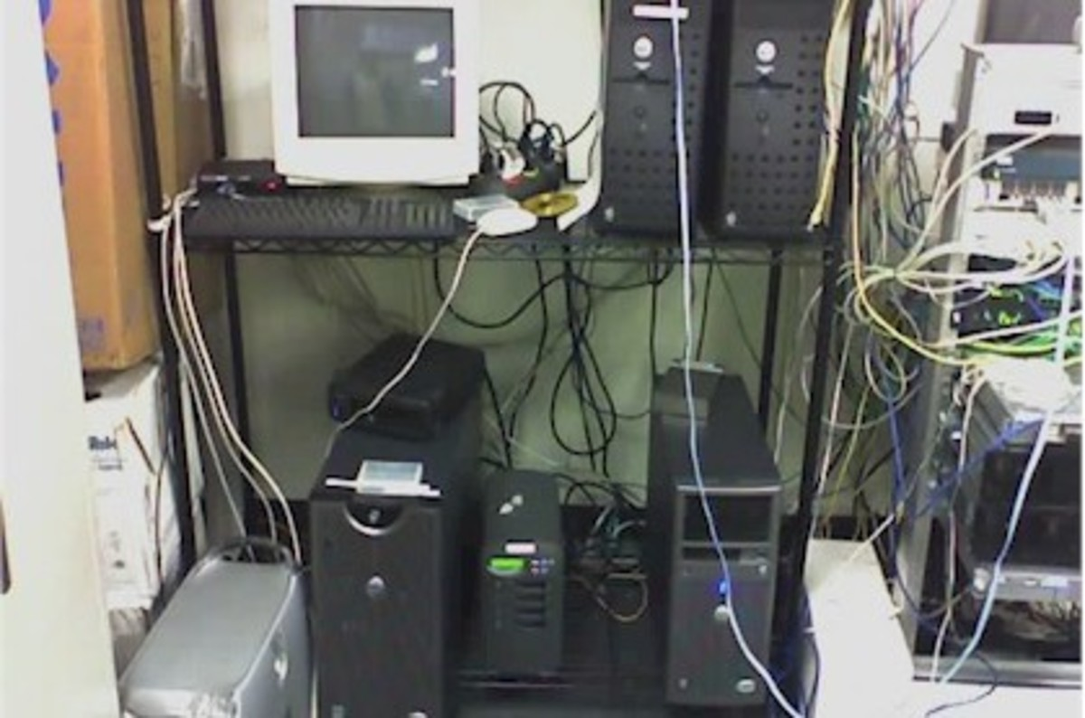
Security

Slide 7

Security

Slide 8
Security
In 2015, 60 percent of all attacks were carried out by insiders, either ones with malicious intent (44.5%) or those who served as inadvertent actors (15.5%). In other words, they were instigated by people you’d be likely to trust. And they can result in substantial ﬁnancial and reputational losses.
-- IBM 2016 Cyber Security Intelligence Report

Slide 9
Security
As a DBA have you feel yourself insecure because of your super power? Any mess happen you are the first guy to say goodbye.

Slide 10
Security
Have you ever get those messages at your cell phone providing attractive offers that you never thought for !!!

Slide 11
Security
Are you getting tired to find a good DBA either for competency or for money.

Slide 12
Security
Have you started thinking to move to Azure at near future?

Slide 13
Why Encrypting the Database
Protecting sensitive data e.g. Credit Card Number, National ID, Mobile Number
Running database and/or application in the cloud
Delegation of DBA role
Prevent high-privileged users from having access to sensitive data
Separation of role between who own data and who manage data
Regulatory Compliance and Audits

Slide 14
History of Database Encryption

Slide 15
History of Database Encryption
SQL Server Version | Type of Encryption
2000 & Before | No native tools Data at Rest could be encrypted by third party tools or by encrypting the entire drive
2005 | Call level encryption
2008, 2012, 2014 | TDE (Transparent Data Encryptions) Certificate base transport encryption
2016 | Always Encryption

Slide 16
Always Encryption

Slide 17
Solution to the issues with earlier encryption
A transparent end to end solution for sensitive columns
All encryption and decryption is handled transparently by the driver library on the client
Allows clients to encrypt sensitive data inside client applications and never reveal the encryption keys to SQL Server
Data is never in plain text while being stored or accessed while on SQL Server (including while in memory)

Slide 18





1. Generate CEKs and Master Key
Column Encryption Key
(CEK)
Column
Master Key
(CMK)
2. Encrypt CEK
Encrypted
CEK
CMK Store:
Certificate Store
HSM
Azure Key Vault
…
3. Store Master Key Securely
CMK
Security
Officer
4. Upload Encrypted CEK to DB
Encrypted
CEK
Database

Slide 19
Type of Keys
Column Master Keys (CMK)
To encrypt column encryption keys
Encrypted values of the keys along with their location are stored on system catalog view
SQL Server does not contain the keys needed to decrypt data
Must be stored in a trusted key store
Column Master Keys must be deployed on each client machine that needs access to the unencrypted data

Slide 20
Type of Keys (Cont.)
Column Encryption Keys (CEK)
To encrypt sensitive data stored in database column
A single key can encrypt all values in a column/ table
Encrypted values of the keys are stored on system catalog view
Store this key in a secured/ trusted location for backup
Each CEK can have 2 encrypted values from 2 CMKs to allow master key rotation

Slide 21
Type of Encryption
Deterministic
Generate same encrypted value for a given text
Allows grouping, filtering and joining
Better chance of data decryption by unauthorized user by examining the pattern especially when applied to a smaller set of data

Slide 22
Type of Encryption (Cont.)
Randomized
Encrypting data in a less predictable manner
More secure because different set of data is generated for same plain text
Prevents equality searches, grouping, indexing and joining

Slide 23
Type of Encryption (Cont.)
Deterministic vs. Randomized
Column that are part of indices (either clustered or non clustered) can’t be encrypted with randomized option
Column referenced by unique constraint can be encrypted with deterministic option
Primary Key columns can use only deterministic option

Slide 24

Encrypted sensitive data and corresponding keys are never seen in plaintext in SQL Server
trust boundary
SQL Server or SQL Database
Client
"SELECT EmpName,EmpSalary FROM Customers WHERE EmpNID = @NID",
“NID_Sultan_1"
"SELECT EmpName,EmpSalary FROM Employee WHERE
EmpNID = @NID",
0x7ff654ae6d
ADO .NET
Cipher text
Result Set
Result Set
Name
Sultan
EmpSalary
$100,000
EmpSalary
0x7ddfddae6
dbo.Employee
Column Encryption Setting = enabled
EmpName | EmpNID | EmpSalary
Sultan | 0x7ff654ae6d | 0x7ddfddae6
Cipher text

Slide 25
Key Rotation
Ensure Compliance Requirement
Ensure Better Security
Rotating of CMK
Provision a new CMK
Encrypt CEK with new CMK (Rotate CMK)
Configure Client
Cleaning Up & Archiving (Clean CMK)

Slide 26
Performance Benchmarking
https://sqlperformance.com/2015/08/sql-server-2016/always-encrypted-performance-follow-up

Slide 27
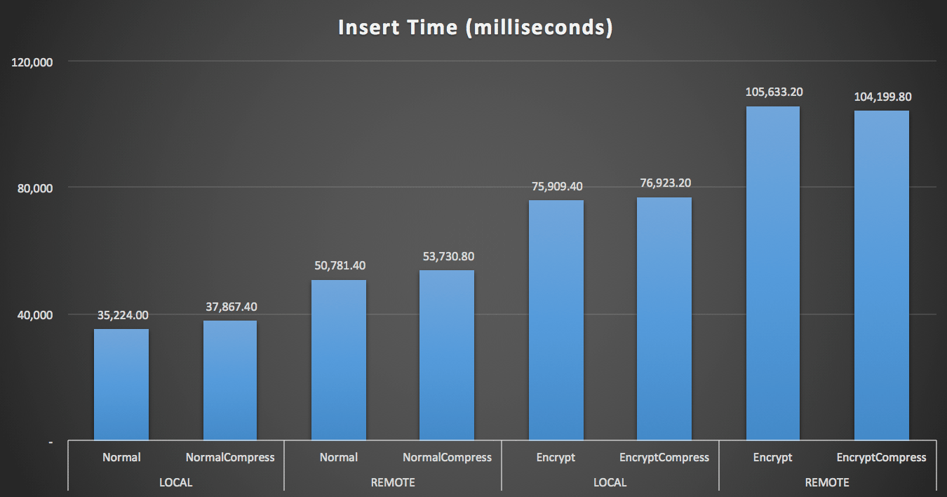

Slide 28
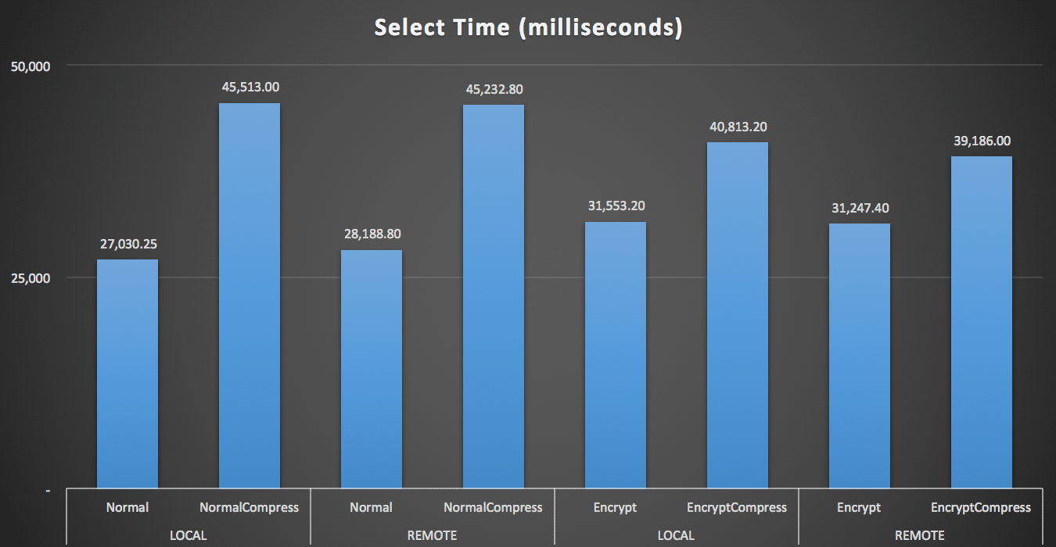

Slide 29
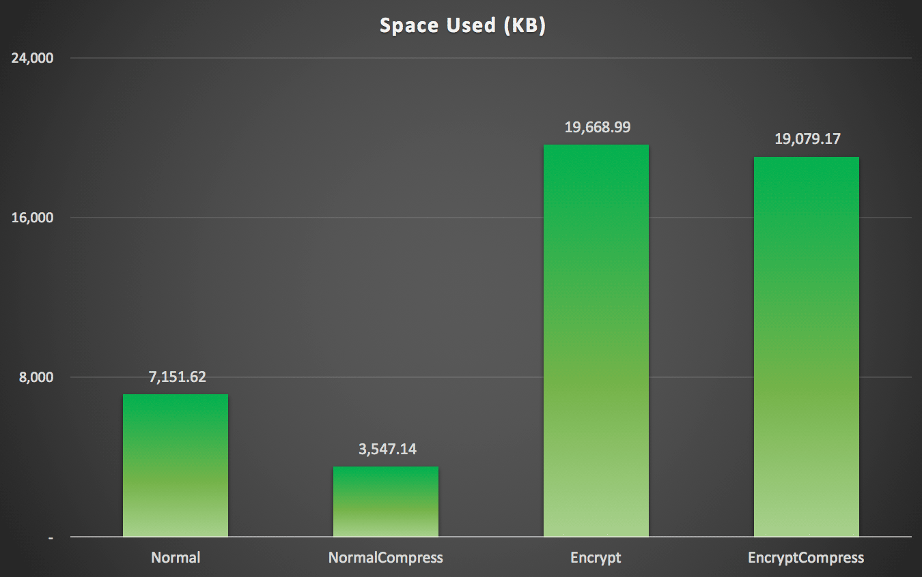

Slide 30
Limitations

Slide 31
Data Type
XML
timestamp/ rowversion
image
ntext/ text
sql_variant
geography/ geometry
User defined type
Non Binary2 Collation string data type
Alias
Sparse column set

Slide 32
Column
Partitioning columns
Columns with default constraints/ check constraints
Referencing column can’t be encrypted with randomized option (for deterministic option the CEK must be the same)
Columns that are keys of fulltext indices
Columns referenced by computed columns when the expression does unsupported operations
Columns referenced by statistics
Table variable columns

Slide 33
Clause
FOR XML
FOR JSON PATH

Slide 34
Features
Transactional or Merge Replication
Distributed Queries (linked servers)

Slide 35
References

Slide 36
Always Encrypted (Database Engine)
https://msdn.microsoft.com/en-us/library/mt163865.aspx
https://channel9.msdn.com/events/datadriven/sqlserver2016/alwaysencrypted
Always Encrypted (Client Development)
https://msdn.microsoft.com/en-us/library/mt147923.aspx
https://blogs.msdn.microsoft.com/sqlsecurity/2015/08/27/using-always-encrypted-with-entity-framework-6
Column Master Key Rotation and Cleanup with Always Encrypted
https://msdn.microsoft.com/en-us/library/mt607048.aspx
Import/Export Windows Cert
http://windows.microsoft.com/en-us/windows/import-export-certificates-private-keys#1TC=windows-7

Slide 37
Thank You & Happy Encrypting !!!
Md. Sultan-E-Alam Khan, PMP®, SMC™, OCP, MCSD | Head of Application, Lanka Bangla
SQLSaturday #533 – Bangladesh 2016

